Slide 1
Sales Forecast
vadaga venkatesh Prasad
CS 689 Project

Slide 2
Overview
The sales of products that are being purchased shows a requirement to have a business evaluation stepping forward.
The sales figures have shown lowering the interest of customer as the sales has dropped due to high competition.

Slide 3
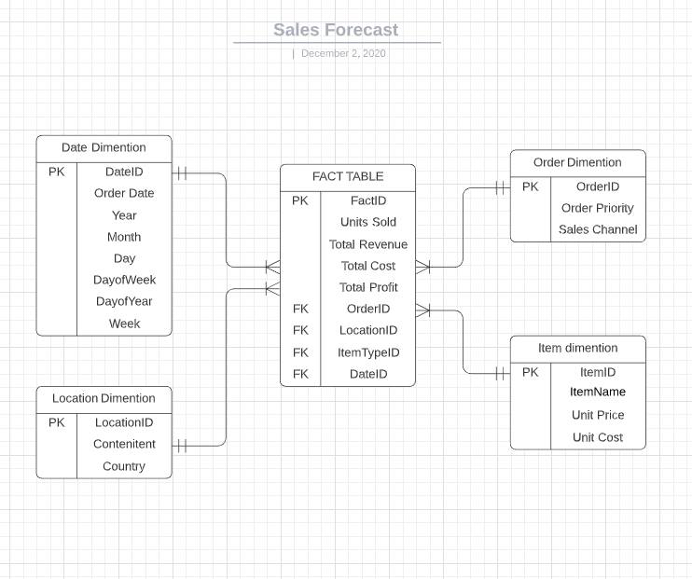
ERD - Diagram
The diagram shows the arrangement of orchestration of diversifying dimensions to have a profound impact on the organization.

Slide 4
Hierarchy and SCd
Date and region have hierarchy
The Date has day ,week ,month , year
The region has continent and country as the hierarchy.
SCD
I considered a possibility of item name as SCD changing .
The Item name is change to attract more varieties.

Slide 5
ETL
I have used a combination of python and SQL server management to prepare the data and insert it into database.
I used tabuleau to understand the behavior of the data.
References : Google / StackOverflow / python documentation / Tablaeu

Slide 6
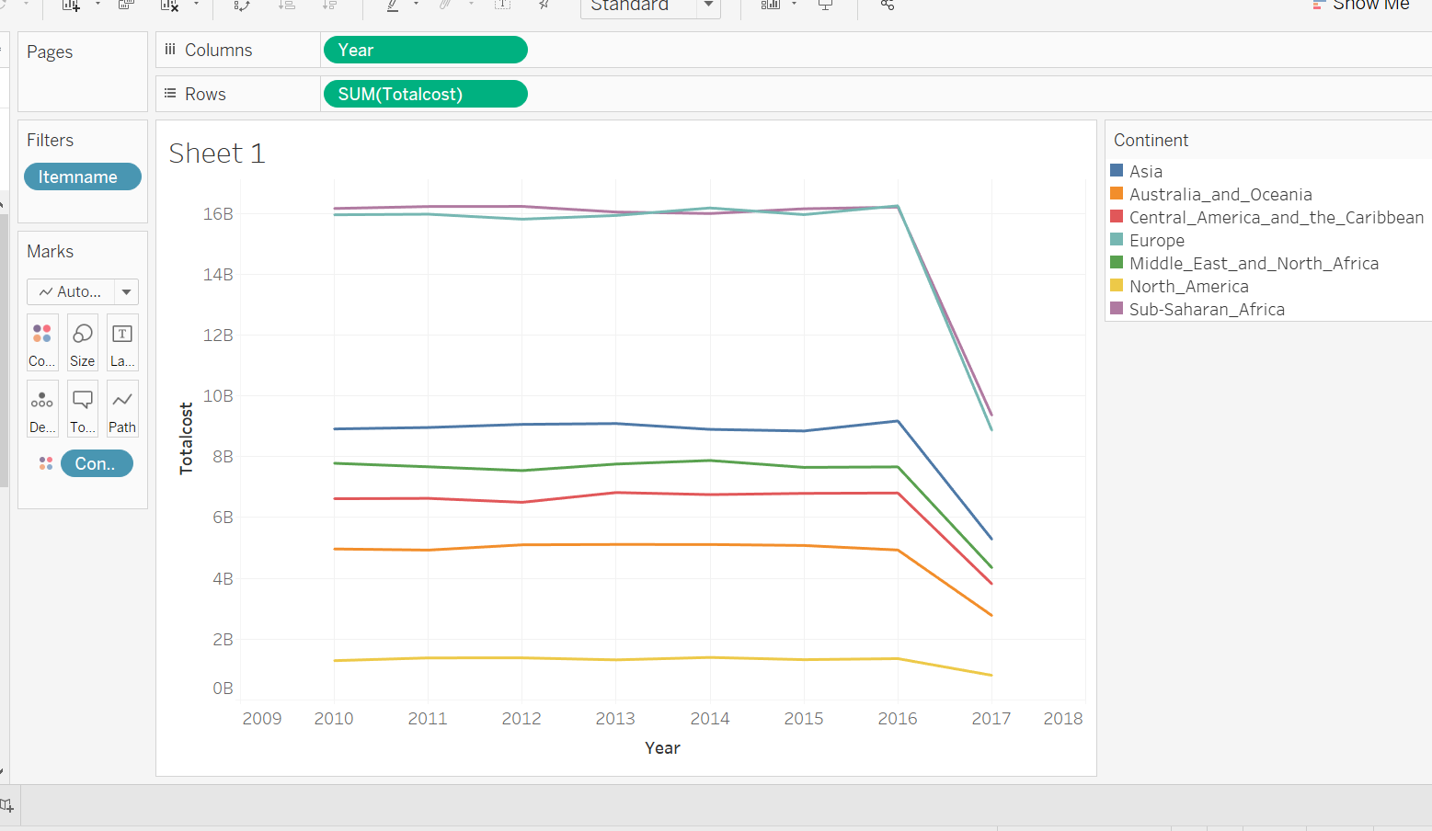
The sheet
Declining sales from 2016 to 2017.
Major costs of purchased by Europe and Sub-Saharan_Africa
Least opportunity of growth is North America.
Asia comes at around 9 Billion total cost .

Slide 7
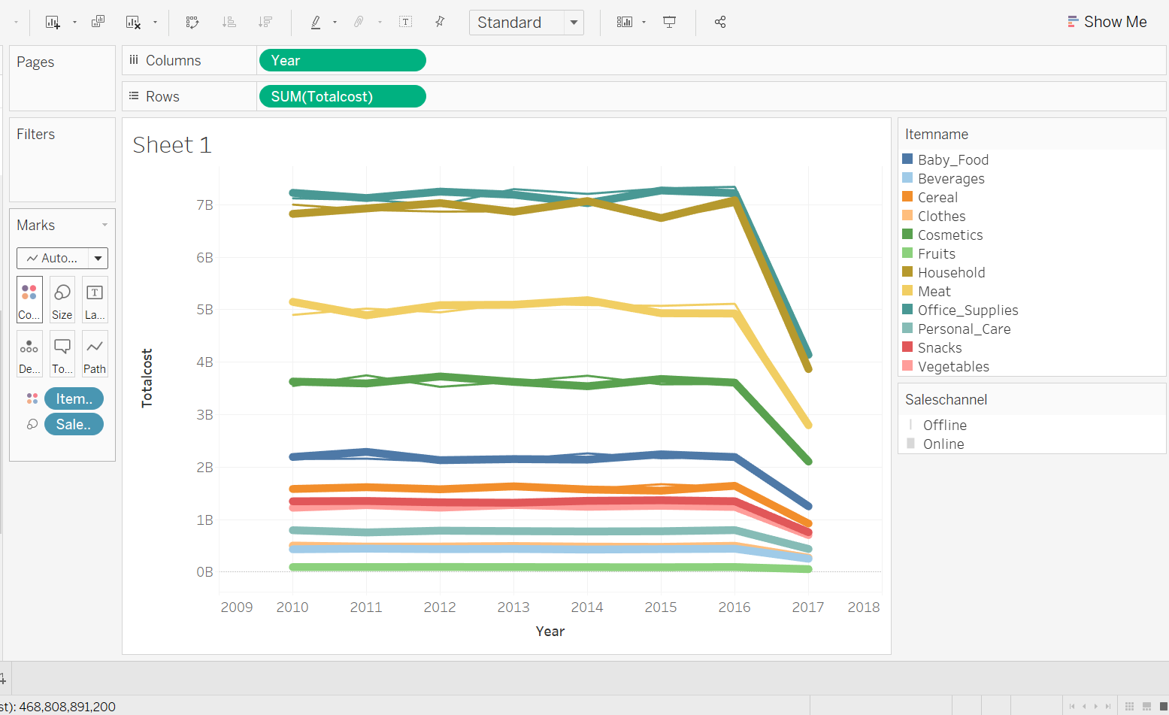
Online Vs offline
Well clearly Online growth over years and Offline are same remain consitant with overall sales.
Major cost items is office supplies followed by household products.

Slide 8
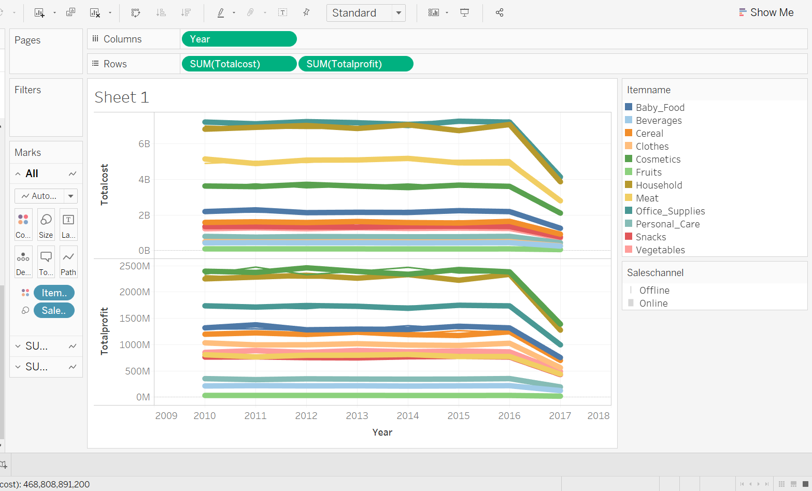
Total cost vs profit
The total cost of cosmetics is less when compared to household and office supplies ,However when it comes to profits .
Baby food have a lower sales but have a higher profit .

Slide 9
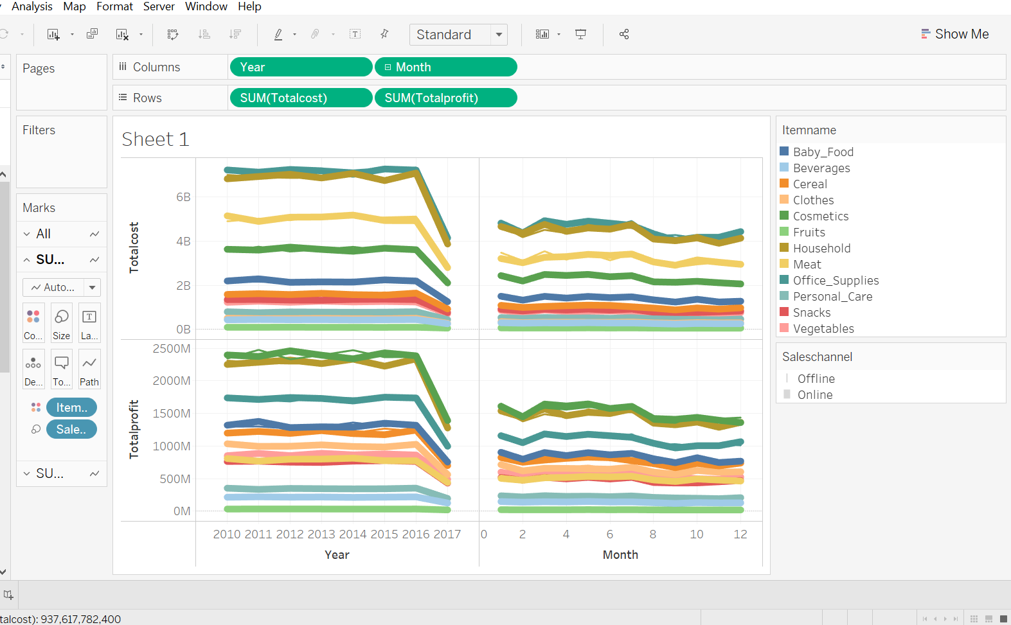
Total cost vs profit
We can see a slight hike in coming to the third month and profits tend to increase in August and slight decline through out the rest of the time.
I have created the hierarchy in tableau

Slide 10
Thank you

